Slide 1
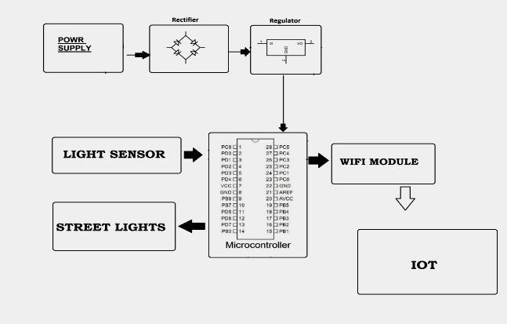
AUTOMATIC STREET LIGHT SYSTEM USING LDR
NAME OF THE TEAM MEMBER:
1. SVEDA N (201EC269)
2. VINOTHINI R (201CE288)
3. VAISHNAVI V (201EC277)
CONCEPT DIAGRAM:
AIM:
To design an automatic street light system using LDR which detects the ambient light and turns on and off the street light.
OBJECTIVE:
The objective of this project is to build an electronic device that can replace the conventional street lights to achieve more energy efficiency. You will be needing a LDR (Light Dependent Resistor) which can detect the light intensity present at the environment and send the data to the microcontroller. You can then program the microcontroller to carry out specific set of actuations (like switching ON/OFF street lamp) based on the value that the sensor provides. Also all the data that is collected will be stored on the cloud for analytics purposes

Slide 2
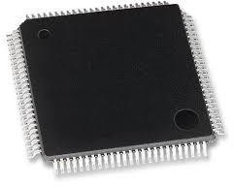
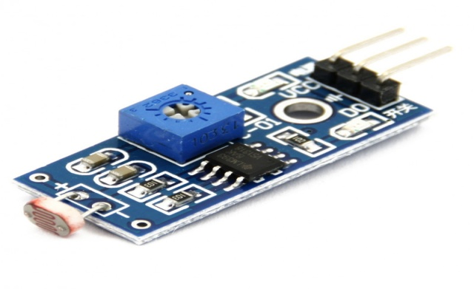
DISADVANTAGES OF EXISTING SYSTEM:
Manual switching off/on of Street Lights
More energy consumption
Expense is high
Manpower is required
ADVANTAGES OF PROPOSED SYSTEM:
Automatic switching of street lights
Cost reduction
Manpower reduction
Wireless communication
Energy saving
METHODOLOGY:
Street lights are the major component of a smart city infrastructure. The important function of street light is to lighten the city streets using sensors to save the current or power energy. In this system we use LED lamps to save current. Using IoT system is used to watch all kind of areas in the cities.
ATMEGA MICROCONTROLLER:
ATMega Microcontrollers belong to the AVR family of microcontrollers and is manufactured by Atmel Corporation. An ATMega Microcontroller is an 8-bit microcontroller with Reduced Instruction Set (RISC) based Harvard Architecture.
LDR SENSOR:
An LDR is a component that has a (variable) resistance that changes with the light intensity that falls upon it. This allows them to be used in light sensing circuits. The most obvious application for an LDR is to automatically turn on a light at a certain light level. An example of this could be a street light or a garden light. Features. Infrared LEDs have to adjust the voltages. LED adapted to various operating voltages.

Slide 3
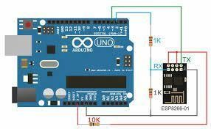
WI-FI MODULE:
The Arduino Uno WiFi is an Arduino Uno with an integrated WiFi module. The board is based on the Atmega328P with an ESP8266WiFi Module integrated. The ESP8266WiFi Module is a self contained SoC with integrated TCP/IP protocol stack that can give access to your WiFi network.
ARDUINO:
CONCLUSION:
The important aim of this paper is to save the current. It is mainly used to protect the power efficiently. Using sensors to save the power energy without any waste.
This system can be used in public places also like hotels, industries, etc. It is control the overflow of current. Manpower not required in this system. This SSLS are mainly used in urban areas and highways to reduce the power wastage to save the current.
THANK YOU

